Slide 1

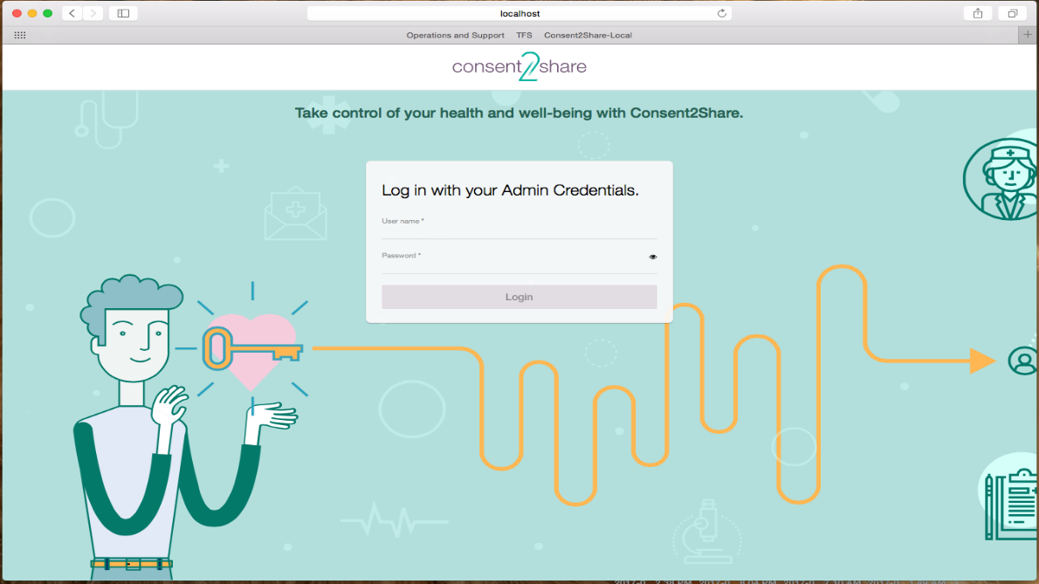


Consent2Share V3.2.0 Provider User Guide
Notes:
Speaker: SAMHSA

Slide 2
About Consent2Share
A secure website that provides patients with 24-hour access to their personal health record
Accessible anywhere using an internet connection
Puts patients in charge of their own health information
Allows patients to share your health records with providers
Allows patients to choose what they wish to share
Allows patients to provide electronic consent for their choices
Allows patients to choose between English and Spanish translations

Slide 3
Provider Roles
Consent2Share allows patients to register and create their own patient user accounts
In addition, Consent2Share allows providers to help patients create their patient user accounts
Providers can complete nearly the entire workflow required to create a patient user account
However, patients must still complete registration steps and only patients can sign online consent
This guide walks providers through patient account creation and several additional processes shown on the next slide

Slide 4
About This Provider User Guide
This Provider User Guide will show you how to:
Create a Patient Account
Enter Patient Demographics
Activate a Patient Account
Add Providers
Create a Consent
Segment Patient Data
Search for Patients
Update Patient Information

Slide 5
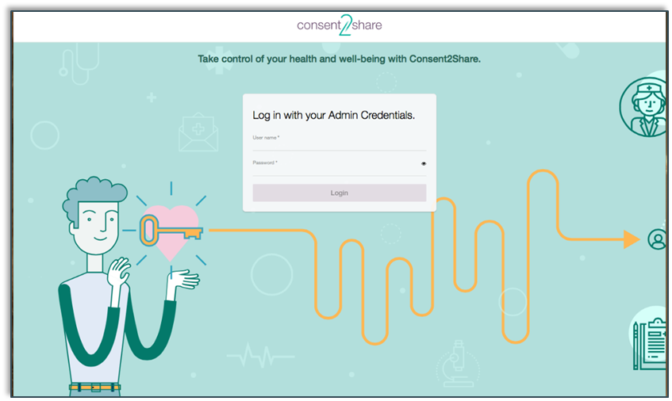
Section 1: Create a Patient Account
First, go to the Consent2Share Provider Portal
Next, enter your provider credentials

Slide 6
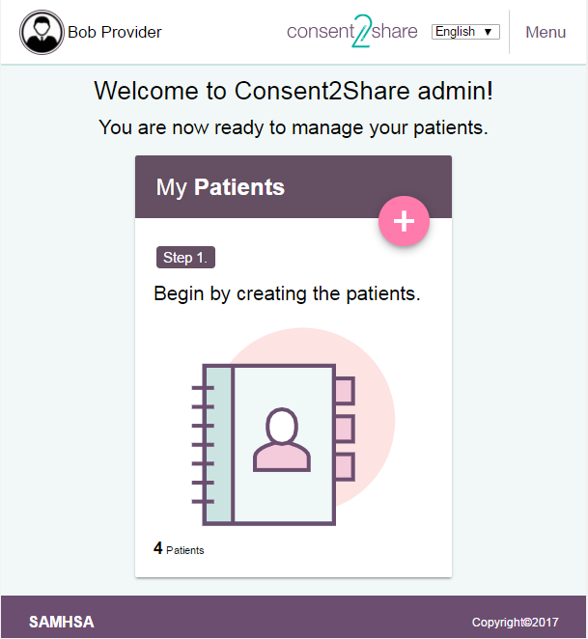
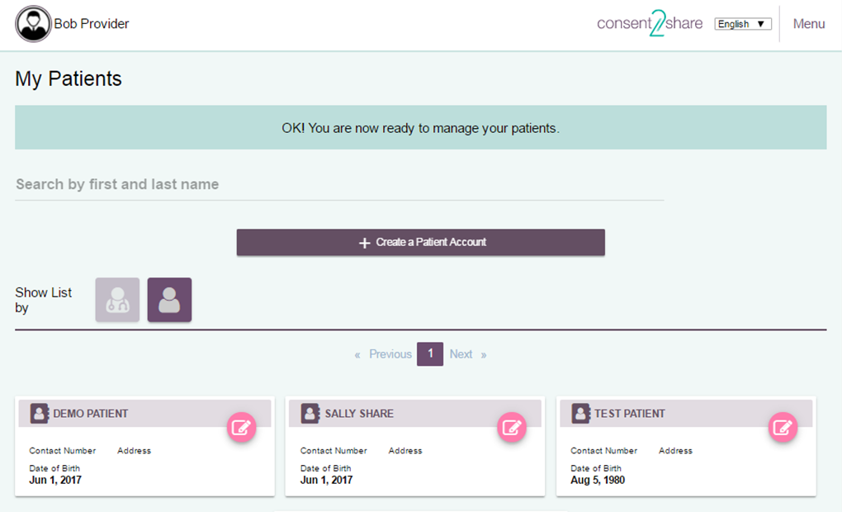
Click the My Patients Card
After login, the Provider Welcome Page opens
Click the My Patients Card
This opens the My Patients Page

Slide 7
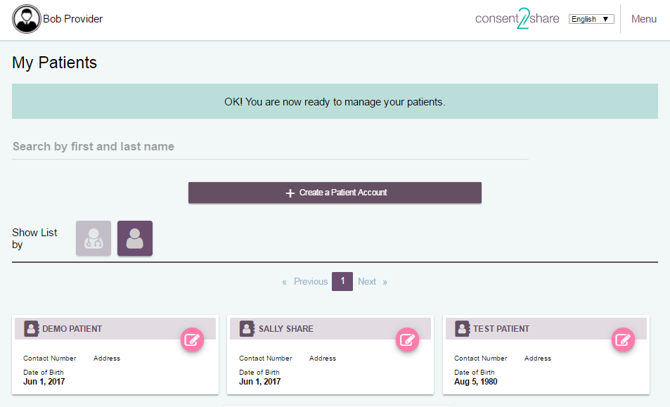

Click the Create a Patient Button
At the My Patients Page, click the Create a Patient Account button

Slide 8
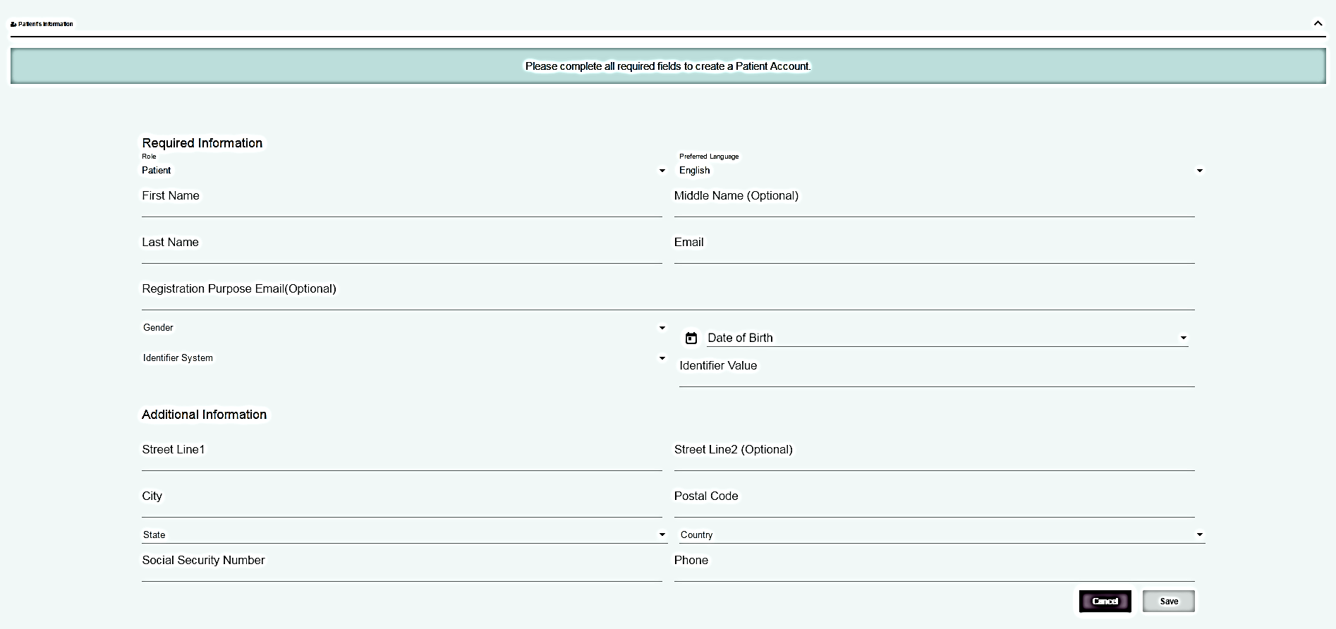
Patient Demographics Page
The Patients Demographics Page will open

Slide 9
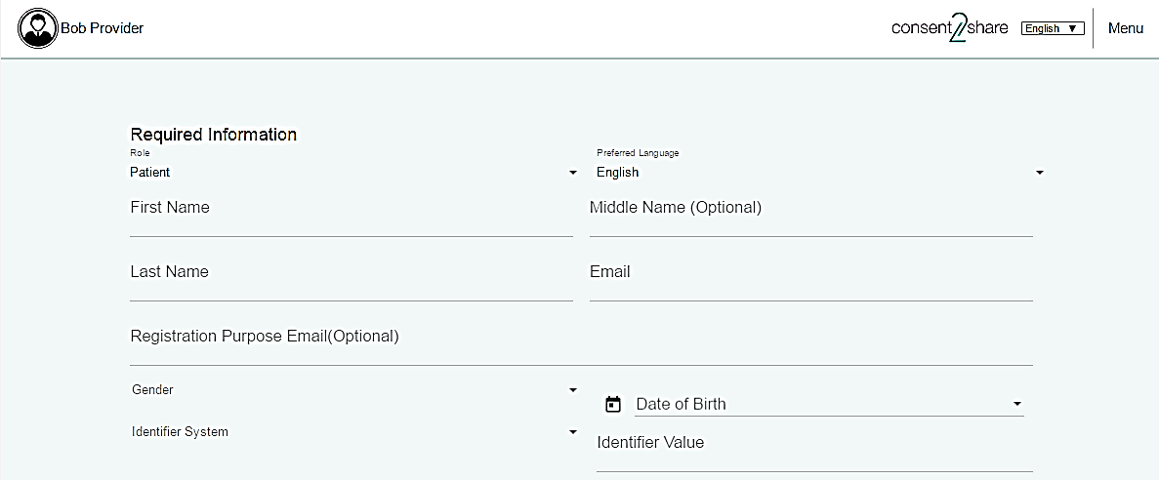
Section 2: Enter Patient Demographics
On the Patient Demographics Page, enter the Required Information
Note that you can choose English or Spanish
Enter patients’ first name, last name, and optional middle name
Enter patients’ email, gender, and date of birth
Enter the Identifier System and Identifier Value

Slide 10
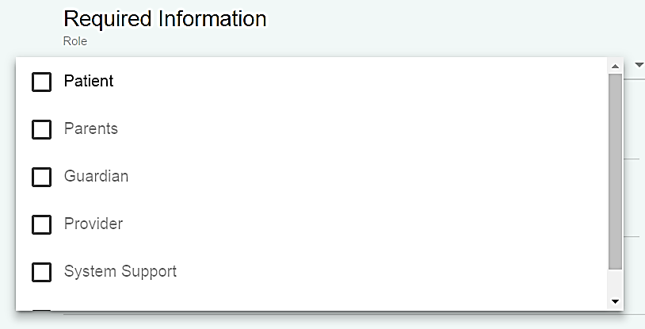
Use Drop-down Menus
Note the drop-down menus for
Role and Language
Gender and Date of Birth
Identifier System and Identifier Value
State and Country

Slide 11
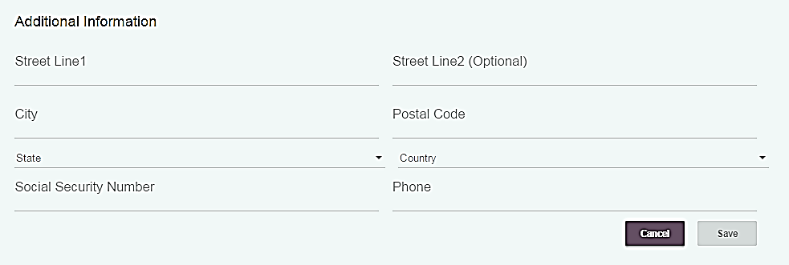
Enter Optional Patient Information
You can also enter optional Additional Information
Address, Social Security number, and phone number
You can enter the information now
Or, you can update patient information later

Slide 12
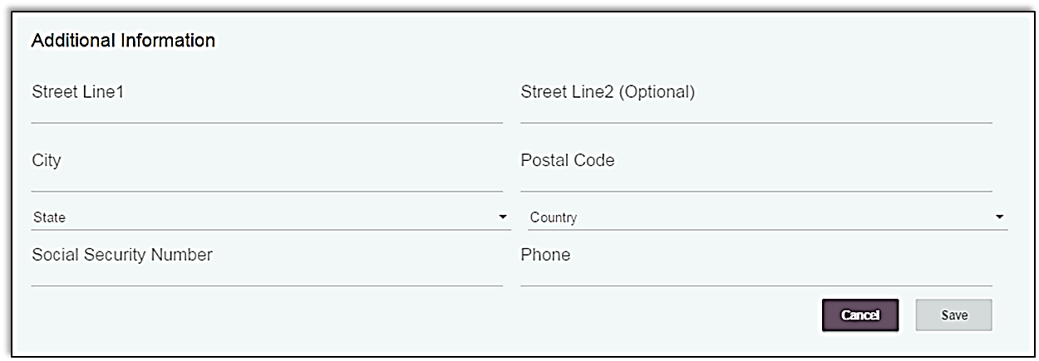
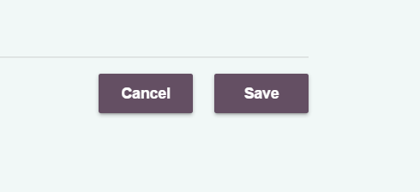

Click Save When Finished
When finished entering patient information, click the Save button

Slide 13
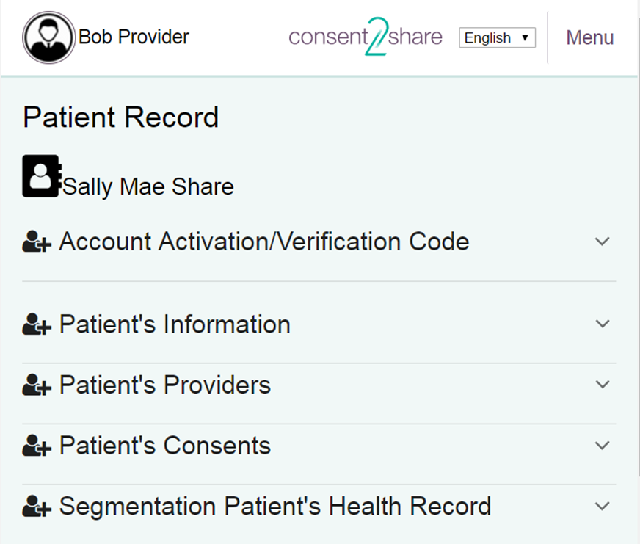
Section 3: Activate a Patient Account
You have now created a patient user account!
The next step is to activate the account
This can be done sending the patient an Account Activation Email and the patient activating the account
The next few slides will illustrate that process

Slide 14
The Patient Record Page
This is the Patient Record Page. Use it to:
Send a patient Account Verification Email
Review a patient’s health record
View and add a provider
Create a patient consent
Segment a patient’s health record

Slide 15
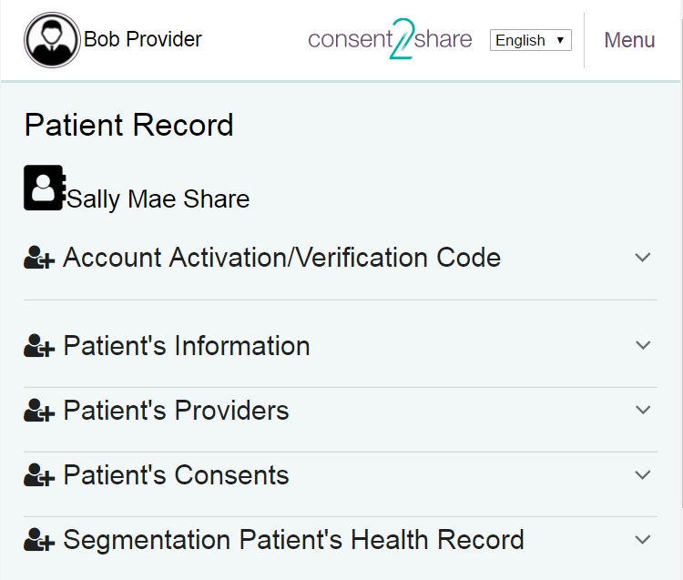
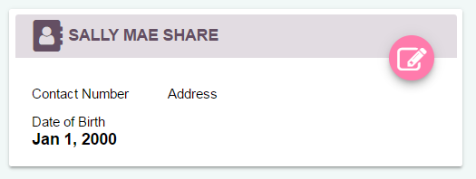
Open Patient Record
To begin the activation process, first click on the Patient Card on the Create a Patient Account Page
This opens the patient’s Patient Record Page

Slide 16
Open Account Activation Page
On the Patient Record Page, click the Account Activation/Verification Code Link
This will open an Account Activation/Verification Page

Slide 17
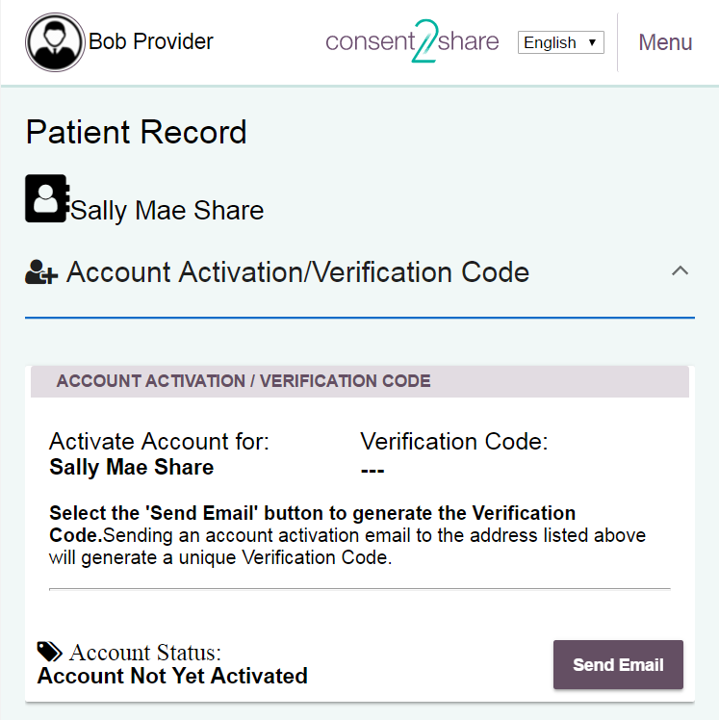
The Account Activation Page
This is the Account Activation/Verification Code Page

Slide 18


Send Account Verification Email
The Account Activation/Validation Code Page explains how to send an Account Activation Email to the patient
Click the Send Email button to generate and email the Verification Code to the patient
You can select language
Note that the account is not yet activated

Slide 19
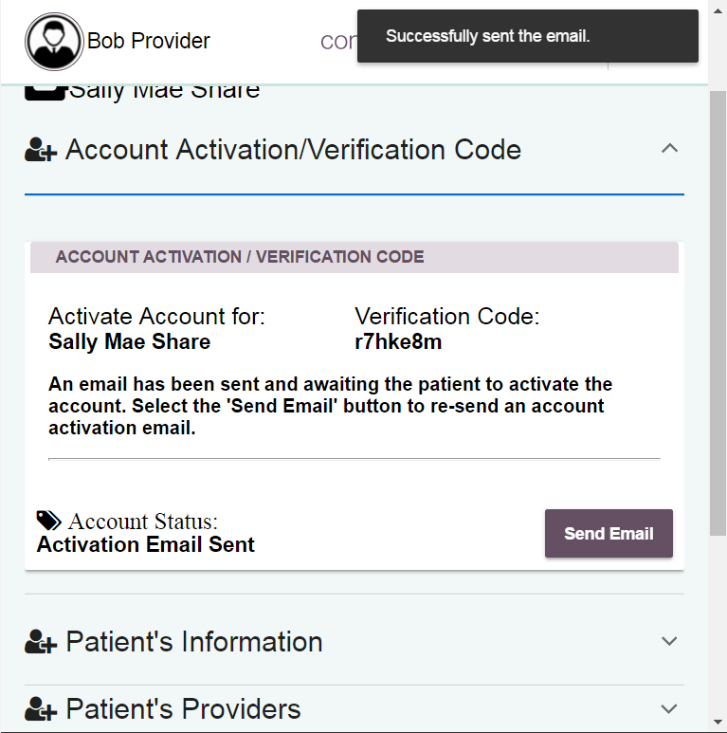


Notification of Sent Validation Code
A verification pop-up at the top of the page will note that the email was successfully sent
The system will generate and reveal the Validation Code
The system will note that the Activation Email has been sent

Slide 20
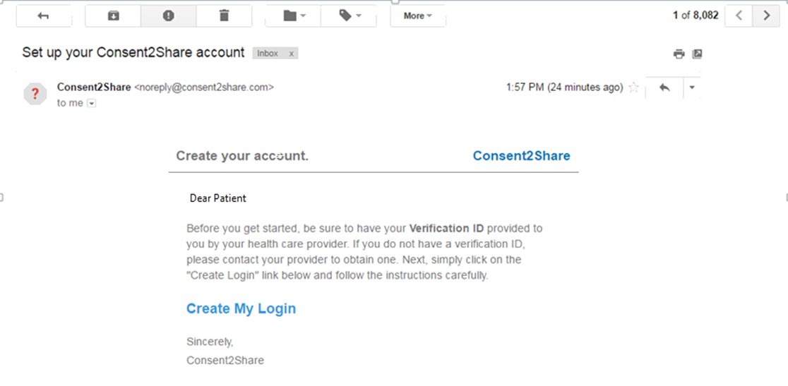
Patient Activates the Account
The patient receives an Activation Email that has a link to Consent2Share, a secure token, and a Validation Code
This allows the patient to enter Consent2Share, complete the account registration process, and activate his or her account

Slide 21
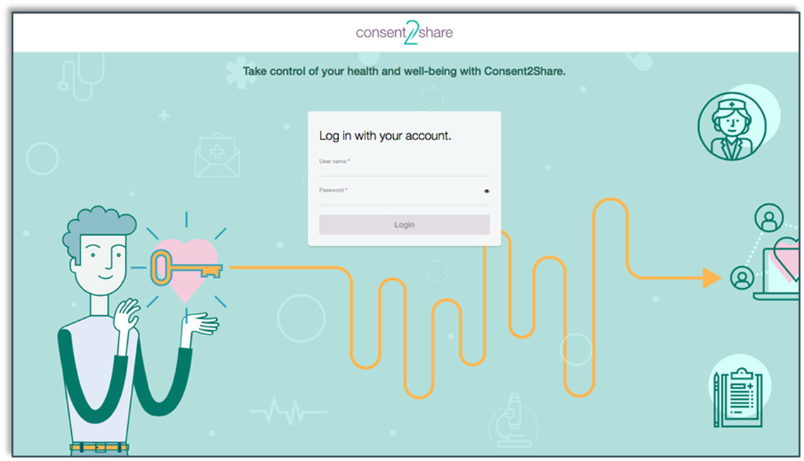
The Patient Account is Now Activated
Once the patient has followed the instructions in the email and completed the account registration process, his or her account is now created and activated
They can now use the patient version of Consent2Share

Slide 22
Section 4: Add Providers
Your patients likely have multiple health care providers
These may include primary care, mental health, addiction treatment, and specialty providers such as dermatologists
Consent2Share enables patients to share all or part of their health information among their providers
Thus, patients’ providers must be added to their accounts
Patients can do this themselves and you can do it on their behalf
The next few slides show how to add providers to their accounts

Slide 23
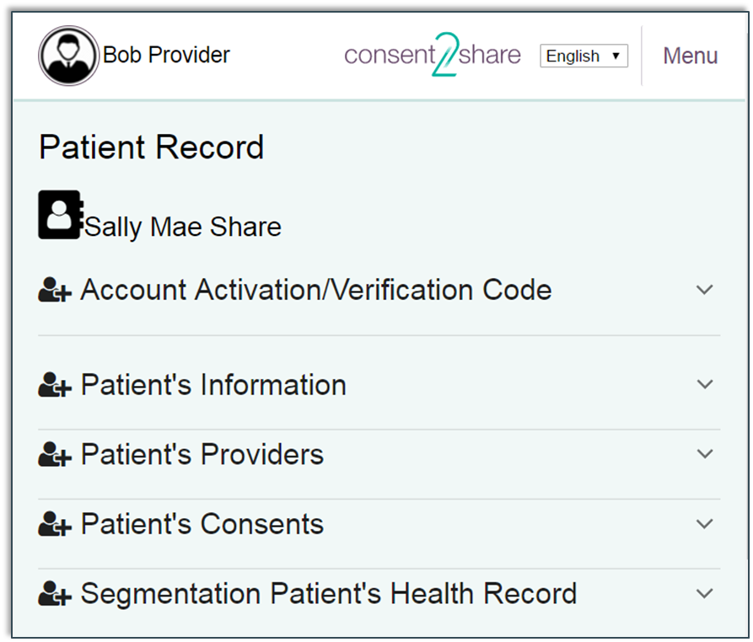

Add First Provider
The first step is to add the first provider
At the patient’s Patient Record Page, select the Patient’s Providers Link

Slide 24
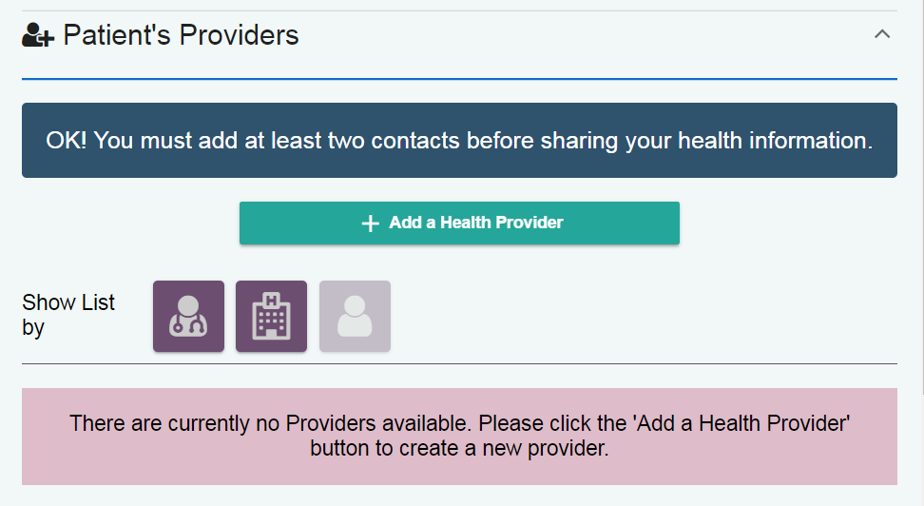
Add First Provider
This will open the Patient’s Providers Page
You can see that the patient does not yet have any providers
Click the Add a Health Provider button

Slide 25
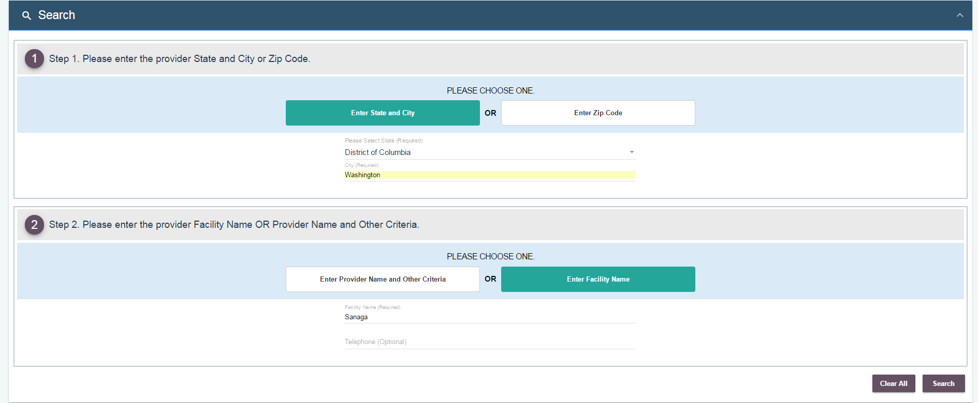

Search for First Provider
This will open the Search Providers Page
Follow the instructions to search for the first provider
When finished, click the Search button

Slide 26
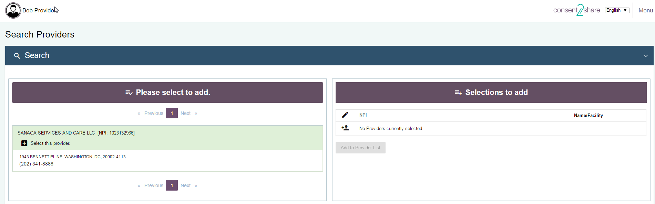
Search for Second Provider
After searching for the first provider, a Search Results page opens
Now, click the Select This Provider + button to add the provider
Note that the provider is temporarily added to the system

Slide 27
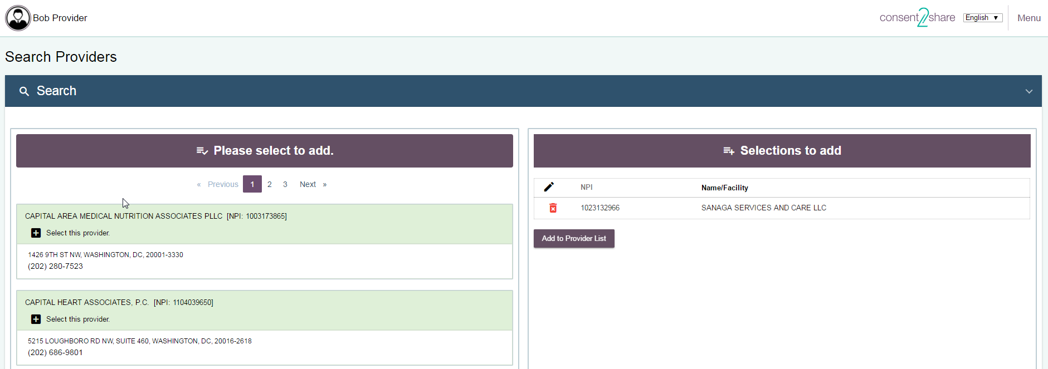
Search for More Providers
Now, you can use the Search function to add additional providers
In the example below, several providers appear
Again, click the Select This Provider + button to add the provider

Slide 28
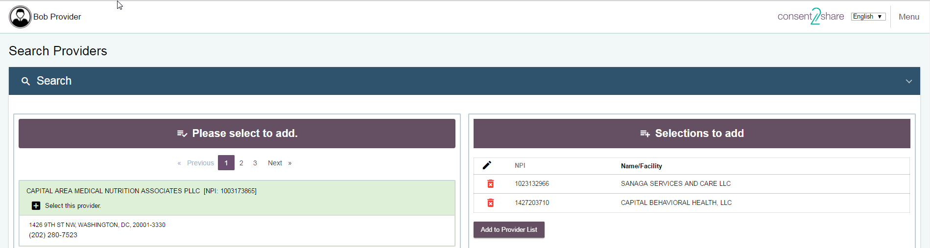

Add to Provider List
We have now selected two providers
They appear in the Selections to Add section
Now, click the Add to Provider List button

Slide 29

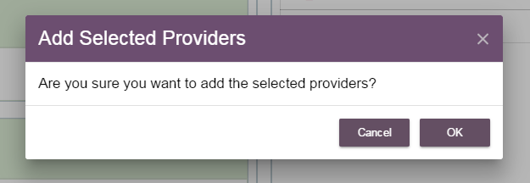

Add to Provider List
We have now selected two providers to add
They appear in the Selections to Add section
Now, click the Add to Provider List button
A message will ask if you want to add the selected providers
Click the OK button

Slide 30
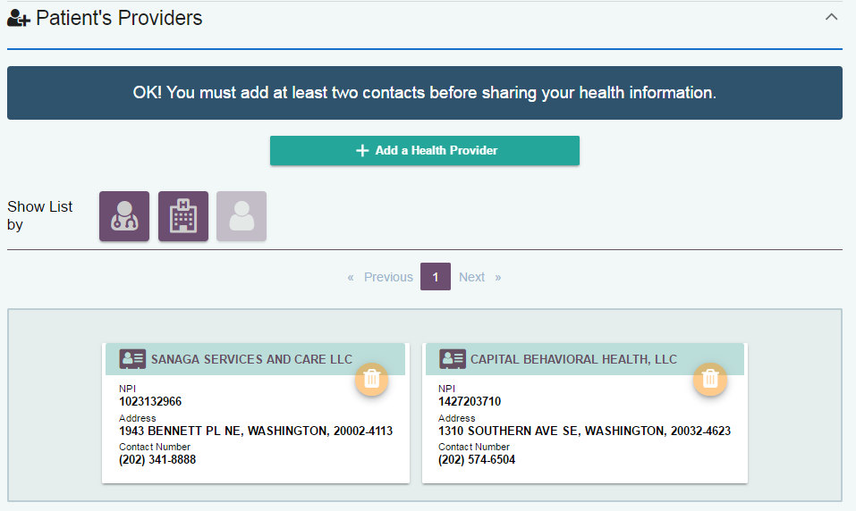
View Results
Click on the Patients’ Providers link on the Patient Record Page
You can see two providers were added to the patient’s account
Now, information can be shared between the two providers

Slide 31
Section 5: Create a Consent
On behalf of patients, providers can use the consent feature to:
Choose to share all or parts of patients’ health records
Choose the reason for sharing your patients’ health records
Select how long records will be shared with a provider
The next few slides will walk you through the process

Slide 32
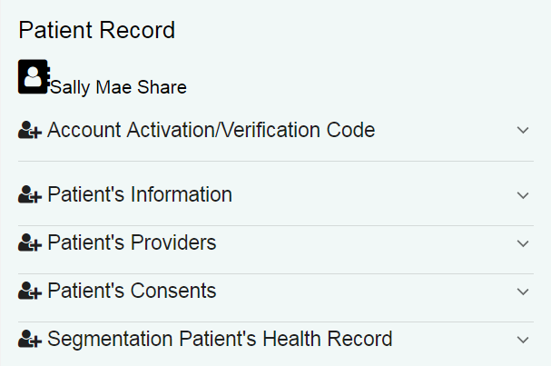
Select Patient’s Consents Link
In practice, each patient will have multiple providers
For this guide, we have added two providers
Now we can create a consent between these providers
First, click the Patient’s Consent Link on the Patient Record Page

Slide 33
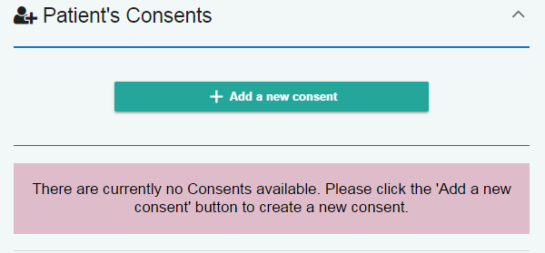

Click the Add New Consent Button
If no consents exist yet, the system will alert you of that fact
Next, click the Add a New Consent Button
The Consent Page will open, as shown on the next slide

Slide 34
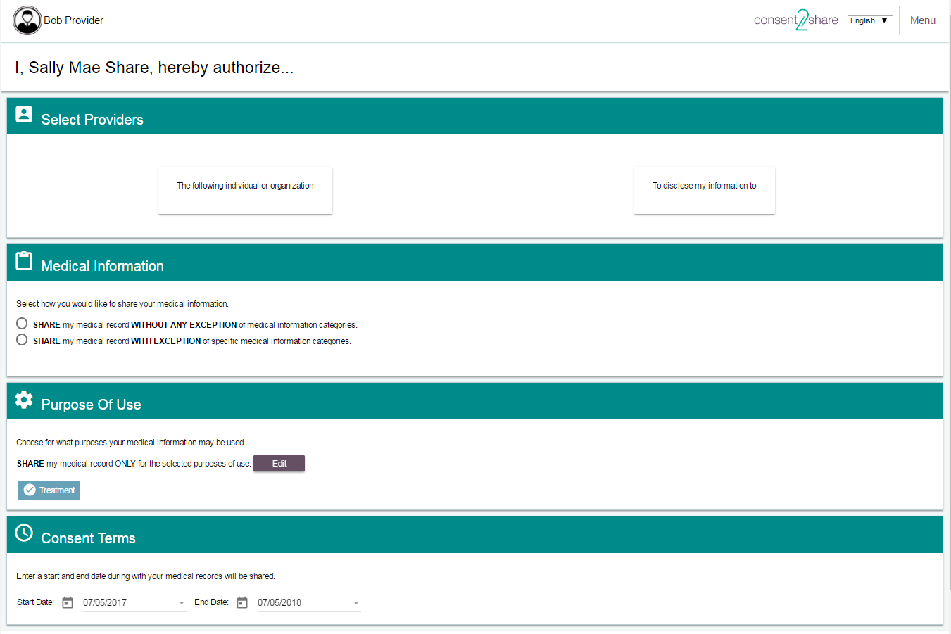
The Consent Page

Slide 35
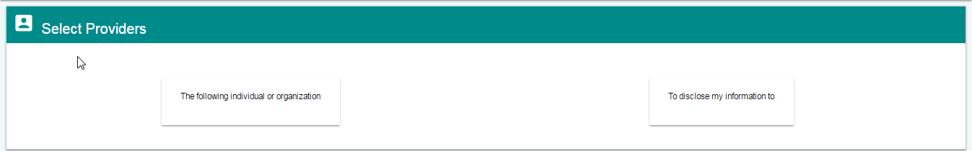
Step 1: Select Providers
You will need to select the “From” and “To” providers

Slide 36
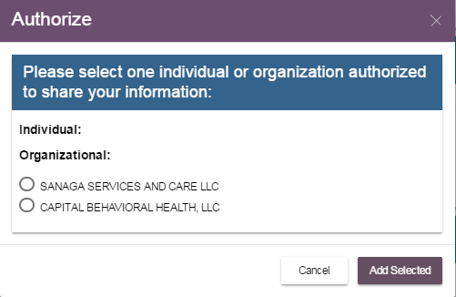
Select the “From” Provider
First, select the “From” organization box
When you do, a pop-up box will open
Select the organization from whom you wish to share
We will choose Sanaga Services and Care

Slide 37
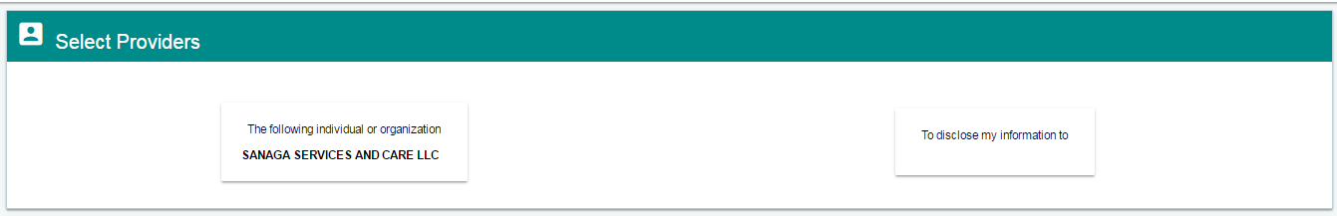
“From” Provider Populates
Now Sanaga Services and Care populates the “From” provider box

Slide 38
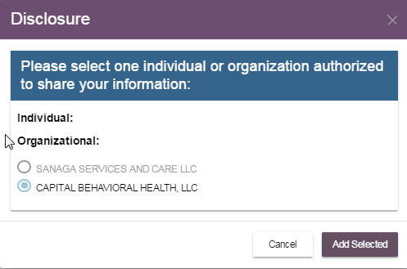
Select “To” Provider
Next, select the “To” organization
When you click the “To” box, a pop-up box will open
Select the organization to whom you wish to share
We have chosen Capital Behavioral Health

Slide 39
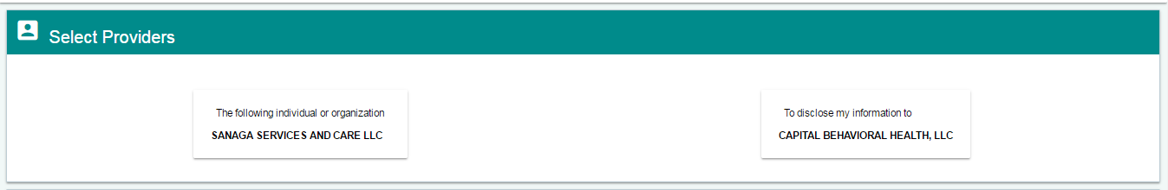
Chose “To” Provider
Now it populates the “To” provider box

Slide 40
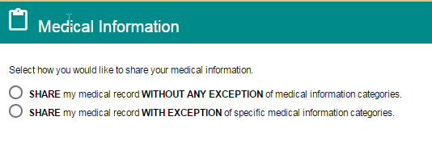
Step 2: Select Medical Information
Next, select how you would like the information to be shared
You can choose:
Share my medical record without any exception of medical information categories or
Share my medical record with exception of specific medical information categories

Slide 41
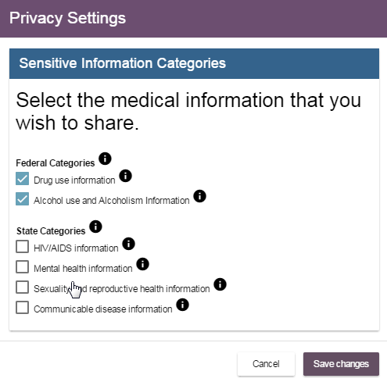
Select Medical Information
We have chosen to share medical records with exceptions
A Privacy Settings box allows selecting sensitive information categories
We will choose to share the first two categories: drug use, alcohol use, and alcoholism information
Click the Save Changes button

Slide 42
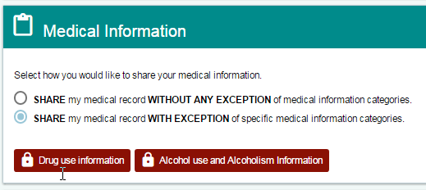
Select Medical Information
After making our choice, the system shows that we have chosen to share:
Drug use Information and
Alcohol use and Alcoholism Information

Slide 43
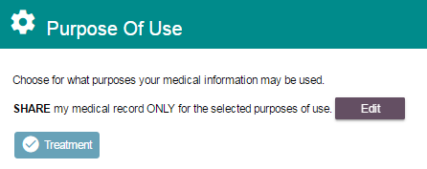
Step 3: Select Purpose of Use
Next, select Purpose of Use
The default setting is “Treatment”
For most patients, this will be the most appropriate setting

Slide 44
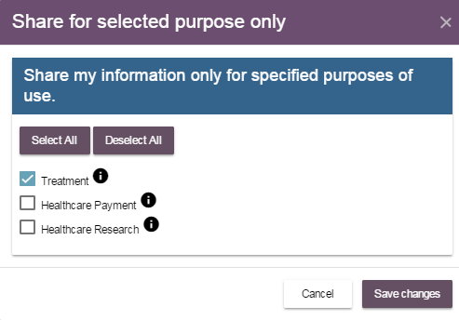
Edit Purpose of Use
If the Edit button is chosen for Purpose of Use, a pop-up window will open
It will allow you to Select All or Deselect All for:
Treatment
Healthcare Payment
Healthcare Research

Slide 45
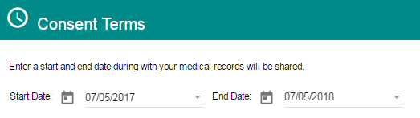
Step 4: Select Consent Terms
Next, select a start date and an end date during which the patient’s medical records will be shared
By default, the system will select today’s date as the start date
The system will select an end date one year in the future
You can choose to edit the start and end dates as needed

Slide 46
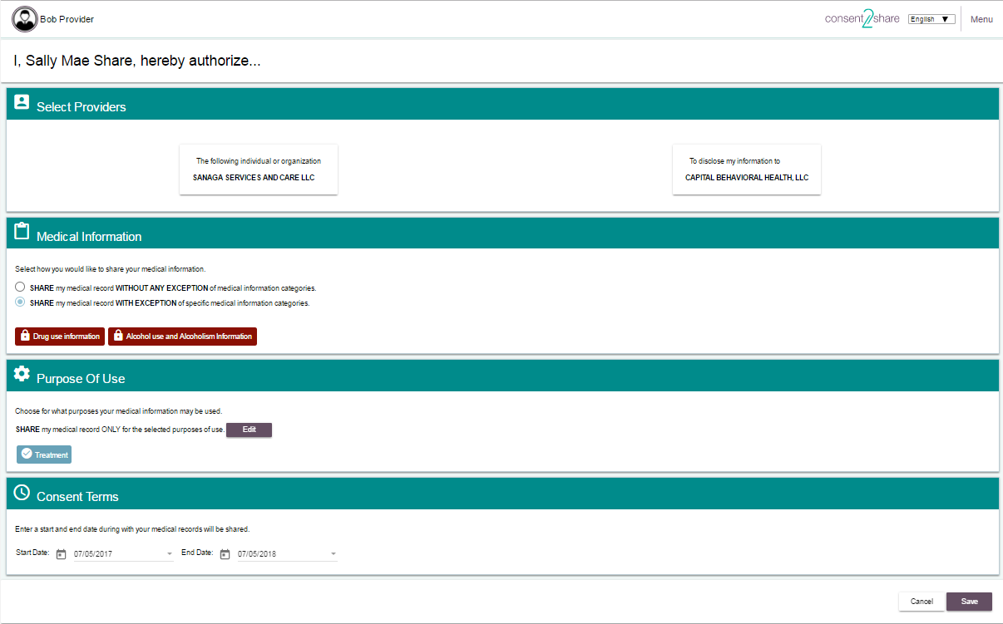
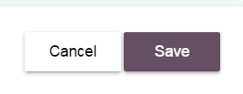
Step 5: Click the Save Button
Click the Save button to save all of the settings

Slide 47

Patient Step 6: Patient Signs Consent
The provider can create patient consents in Consent2Share
However, the patient must electronically sign his or her consents
To do so, the patient must have activated his or her account
The following Patient Step slides show the steps patients take
First, they enter the Consent2Share Patient Portal

Slide 48
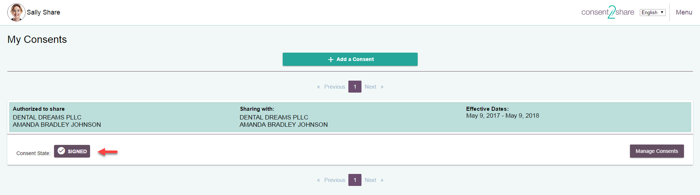
Patient Step 6.1: Consent Management
Patients can view his or her My Consents Page
It shows status of all the consents created
Clicking on the Manage Consents button opens up pop-up window to help patients manage their consents

Slide 49
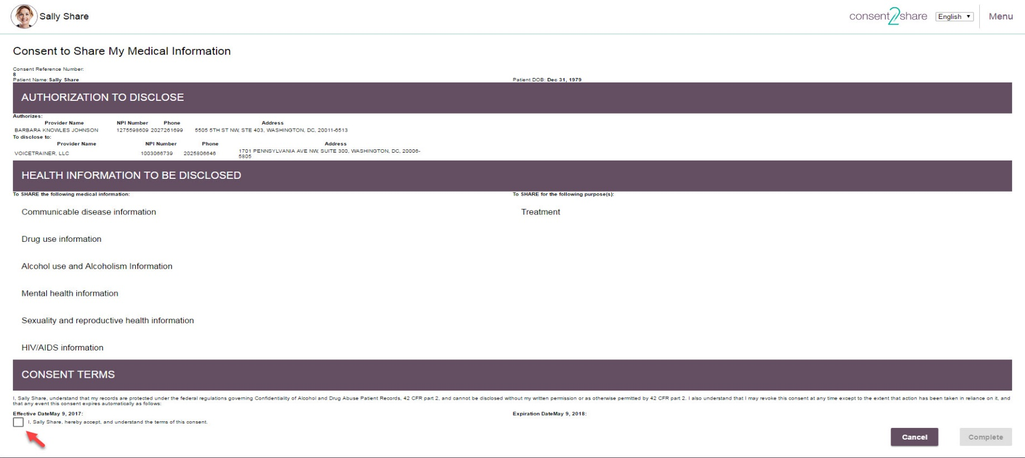
Patient Step 6.2: Signs Attestation Box
Patients can then check the Consent Terms shown below

Slide 50
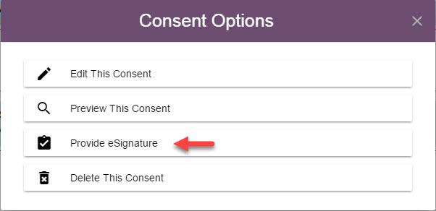
Patient Step 6.3: Provides eSignature
From the List Consents Page, patients click on Manage Consents
From the Consent Options pop-up window, they can select Provide eSignature
That brings patients to the Consent to Share My Medical Information Page

Slide 51
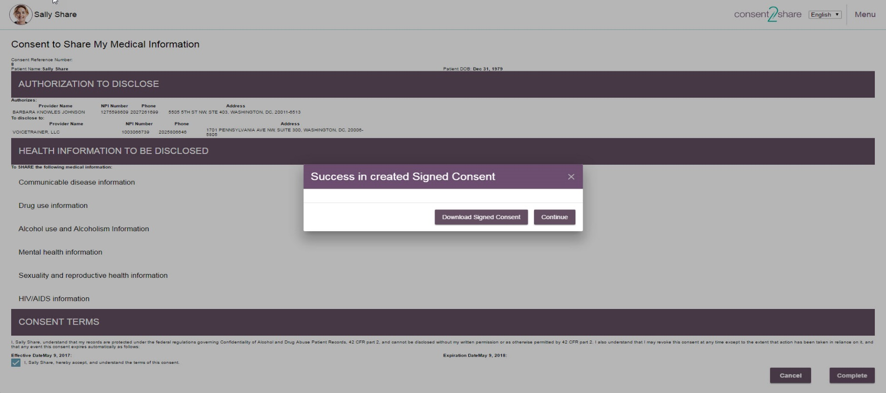
Patient Step 6.4: Receives Confirmation
Patients click the Complete button after authenticating
They have created a consent by electronically signing it
They will receive a pop-up consent success notice

Slide 52
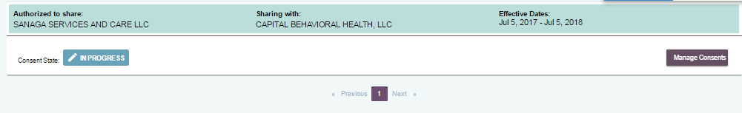

Before Patient Signs Consent
Before the patient signs the consent, the consent status will be shown as “In Progress”

Slide 53
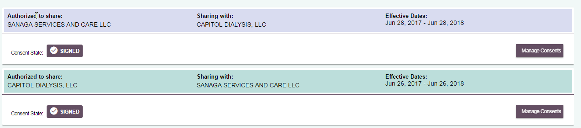
After Patient Signs Consent
After the patient signs the consent, a “Signed” icon will show that the consent has been signed

Slide 54
Section 6: Segment Patient Data
There may be situations in which you receive a request from another provider for you to share your patient’s sensitive health data
Consent2Share allows you to segment health data on behalf of your patient
To do so, your patient must first sign a consent for you to share his or her health data with another provider
The next few pages will illustrate how to segment health data on behalf of your patients

Slide 55
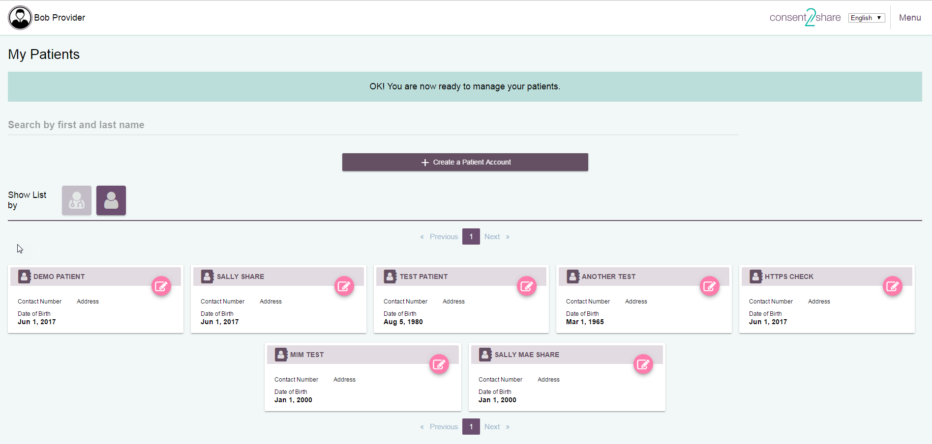
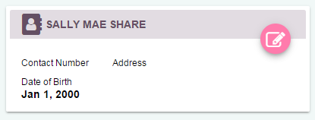
Select Your Patient
Now, select your My Patients Page and select the patient

Slide 56


Select Document Segmentation
Select the Segmentation Patient’s Health Record Link

Slide 57

Select Segmentation
Select the Segment Patient’s Health Record Page

Slide 58

Enter Provider NPIs
Enter the NPI number for the Authorized Provider (the “From” provider)
Enter the NPI number for the Disclose Provider (the “To” provider)
Note that it will populate the providers’ names or practices

Slide 59

Entering Provider NPI Numbers
Confirm the NPI populates the correct provider
If the entered NPI number is not found or if the wrong NPI is used, the segmentation will be unsuccessful or involve an incorrect provider

Slide 60
Select Purpose of Use
Select the Purpose of use:
Treatment
Healthcare Payment
Healthcare Research

Slide 61

Attach Document to be Segmented
Attach the patient’s health data on file pulled from your EHR to segment
We will attach a C-CDA document in XML format
Click the Segment Document Button

Slide 62

Download Segmented Document
After you click the Segment Document Button, segmentation will begin.
When done, a Download Segmented Document message will appear

Slide 63

Results: Segmented Document
You can then save the segmented document on your computer or other appropriate location
This example is a segmented C-CDA in XML format
Now you can send the segmented information to the requestor via a secure method

Slide 64

Section 7: Search for Patients
Consent2Share includes a patient search feature
First, log into the Provider Portal using your provider credentials
Next, select the My Patients card
That will open the Provider page

Slide 65

Begin Typing Patient’s Name
Begin typing the patient’s name in the search input field
The dropdown box will populate the names that match your input
Roll your cursor over the names and they will highlighted
Click the highlighted name whom you are searching

Slide 66

Select Highlighted Name
After you click the highlighted name, the system will open that patient’s Patient Record
Now you can carry out any of the tasks described above

Slide 67
Section 8: Update Patient Information
Consent2Share allows providers to update their patient’s information
First, log into the Provider Portal using your provider credentials
Next, click the My Patients card
That will open the Provider page

Slide 68

Select Appropriate Patient
At the Provider Page, select the appropriate Patient Card
That will bring you to the relevant Patient Record Page

Slide 69
Section 9: Update Patient Information
Once the Patient Record page opens, you can:
Enter information that was not previously entered
Modify information that changed since the account was created
Click the save button after you modify any information

